Slide 1
2nd school

Slide 2
Benefits Of Playing Sports
The health benefits of playing sports include proper weight management, efficient functioning of the heart, controlled diabetes, lower cholesterol levels, improved blood circulation, and lower hypertension and stress levels. It helps in the toning of muscles and strengthening of bones. It also brings positive energy, discipline, and helps in building self-esteem and mutual respect.
Playing sports is a favorite activity for many people around the world. It provides us with enjoyment and also freshens up our mind. However, playing sports is actually more than running, jumping, or kicking a ball on the field. Indulging in sports helps our body function smoothly and more efficiently. Sports involve the activity of each and every muscle in our body. This strengthens the body and promotes good health.

Slide 3
Health Benefits of Playing Sports
Healthy Heart
Playing sports helps with stretching ability. The heart benefits the most from playing sports and there are fewer chances of malfunctioning of your heart. Playing sports helps the heart in pumping more blood as it is a type of workout for the body.
Diabetes Control
Playing sports helps the insulin perform in a better manner. This helps diabetics make most of the insulin present in their body. Also, physical activity helps in reducing the risk of type 2 diabetes. It can also help in weight management since it burns excess calories.

Slide 4
Weight Management
Obesity is a big issue faced by millions of people across the world. This issue can be dealt with indulging in loads of sports or similar physical activities. Fat gets burnt and calories are shed through the rigorous physical activity involved in sports. People who regularly play sports are naturally leaner and fitter.

Slide 5
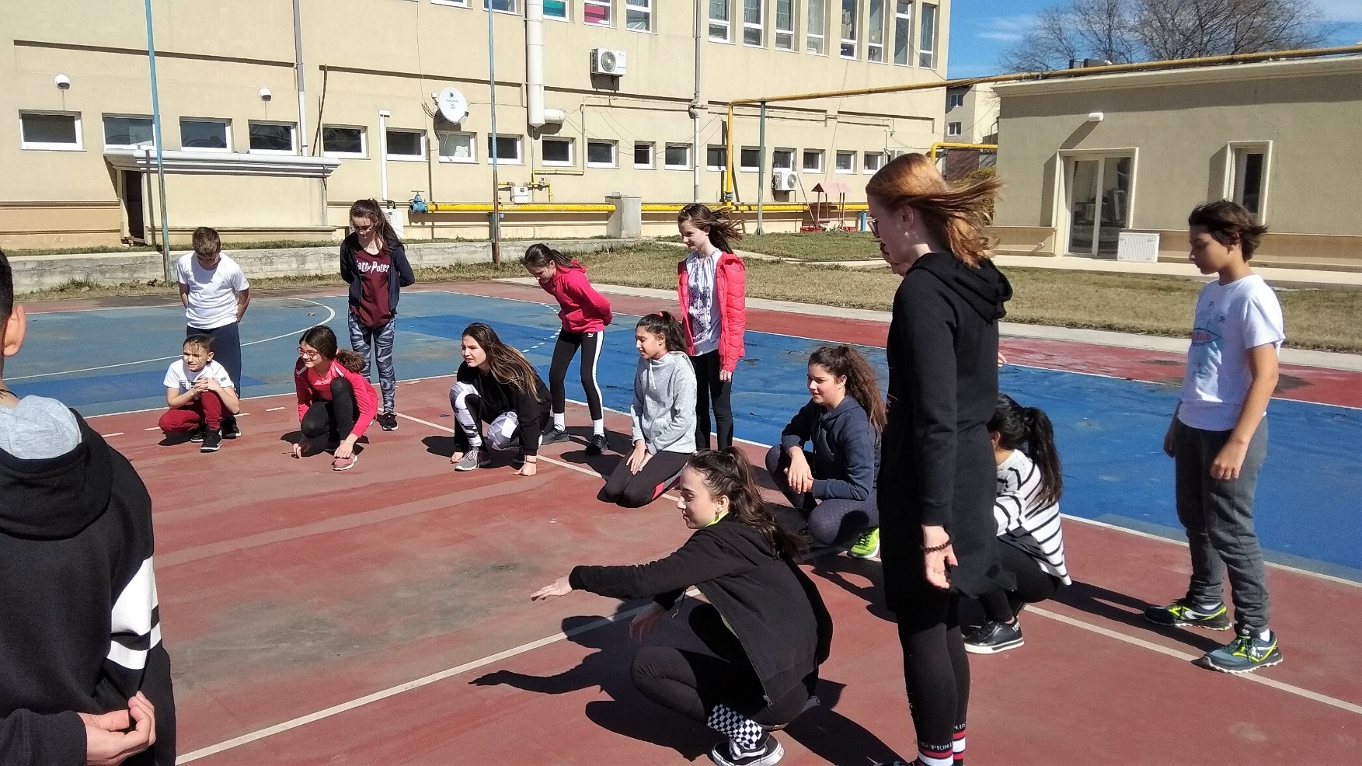
Healthier Relationships
Most sports involve working cohesively in a team environment. Even sports with individual scores, such as swimming, have a team-building component, such as when that swim team goes to a swim meet in another city. With that team component can come more cooperation skills, more focus and more commitment. All of that can lead to healthier relationships with other people and a healthier outlook on life.

Slide 6
Stronger Immunity
Regularly indulging in exercise and sports makes the body immune to many diseases that usually affect a person due to weak immunity. When a person exercises, the rate at which white blood cells reach every body part increases significantly. Playing sports increases sweat production and also removes toxins. Due to the rise in body temperature, the chances of bacterial growth also lessen.

Slide 7
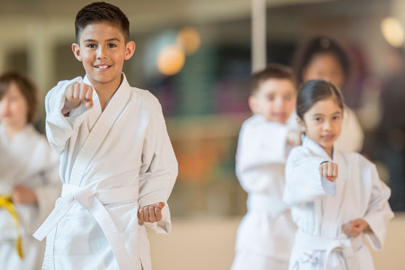
Discipline
Discipline becomes a natural part of life when you start spending time in playing sports. This is because sports inspire people to live life by certain rules and regulations and move towards a positive end. Children who indulge in sports feel healthier, and develop better and healthier relationships with other people because a positive, team-based outlook is instilled in them.

Slide 8
Mutual Respect
Playing sports builds mutual respect. It helps you to respect people even if they have a negative attitude towards you.
Calmness
Sports train your mind to think calmly and find new strategies to deal with problems without getting too hyper.

Slide 9
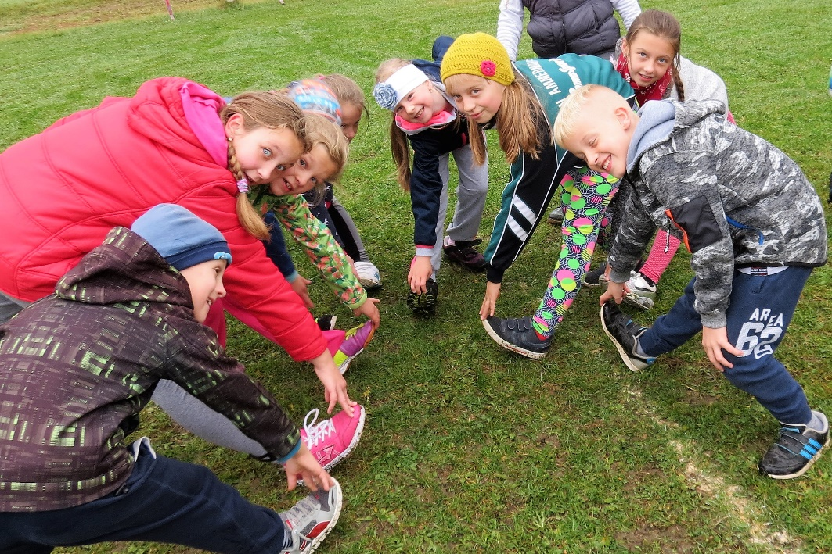
Teamwork
Playing sports helps you build good relationships with people from diverse backgrounds and traits.
It encourages teamwork and thus helps in preparing you to work with different people in a harmonious manner.

Slide 10
Goal Setting
Goal setting means that every person needs to have an idea about what he/she wants, whether it is in a game or in life. Sports may help in goal-setting and will improve performance levels in other areas of life.

Slide 11
Presented by: Scoala Gimnaziala "Grigore Moisil Ploiesti
Cooperating with partner schools:
ZŠ sv. Andreja Svorada a Benedikta Skalité
2nd school of Mikra, Trilofos, Grécko
LTTA ROMANIA, Ploiesti
08.03. – 15.03.2019

